Slide 1
Amazon Sales Data Analytics
Made by Preity Vasudevan Kondath

Slide 2
Introduction
Amazon, founded in 1994 by Jeff Bezos, has evolved into a global technology and e-commerce giant.
Headquartered in Seattle, it initially focused on online book sales but rapidly diversified into various product categories and services.
Renowned for its customer-centric approach, Amazon offers a vast selection of goods, digital content, and cloud services.
The company's innovative ventures include Alexa-powered devices, Amazon Web Services (AWS), and original content production through Amazon Studios, solidifying its position as a leader in the tech and retail industries.

Slide 3
Details of Dataset
The provided dataset contains detailed information on Amazon sales transactions, including attributes such as region, country, item type, sales channel, order priority, order date, order ID, ship date, units sold, unit price, unit cost, total revenue, total cost, and total profit.
The data spans various regions, capturing diverse product categories and sales channels. This comprehensive dataset serves as a foundation for performing in-depth analytics and uncovering valuable insights into sales trends, geographical patterns, and factors influencing profitability within Amazon's extensive business operations.

Slide 4
Major KPI’s
1. Total Revenue: - Measure the overall income generated from sales.
2. Total Profit: - Evaluate the net profit obtained after deducting total costs from total revenue.
3. Average Unit Price: - Determine the average price at which units are sold.
4. Average Unit Cost: - Assess the average cost incurred per unit.
5. Profit Margin: - Calculate the percentage of profit in relation to total revenue.
6. Units Sold: - Track the total quantity of units sold.
7. Average Order Processing Time: - Evaluate the average time taken from order placement to shipment.
8. Region-wise Sales Contribution: - Analyze the proportion of sales contributed by different regions.

Slide 5
Major KPI’s
9. Product-wise Sales Contribution: - Identify the top-selling product categories based on revenue.
10. Sales Channel Distribution: - Assess the distribution of sales across different channels (Online/Offline).
11. Order Priority Distribution: - Understand the distribution of order priorities (High, Medium, Low).
12. Monthly Sales Trends: - Monitor the variation in sales on a monthly basis.
13. Yearly Growth Rate: - Calculate the percentage increase in total revenue year over year.
14. Customer Acquisition Cost (CAC): - Determine the cost associated with acquiring each customer.
15. Return on Investment (ROI): - Evaluate the effectiveness of investment in terms of profit generated.

Slide 6

Analytics Dashboard
137.35M
Total Revenue
93.18M
Total Cost
44.17M
Total Profit
19.10K
Unit Cost
27.68K
Unit Price

Slide 7
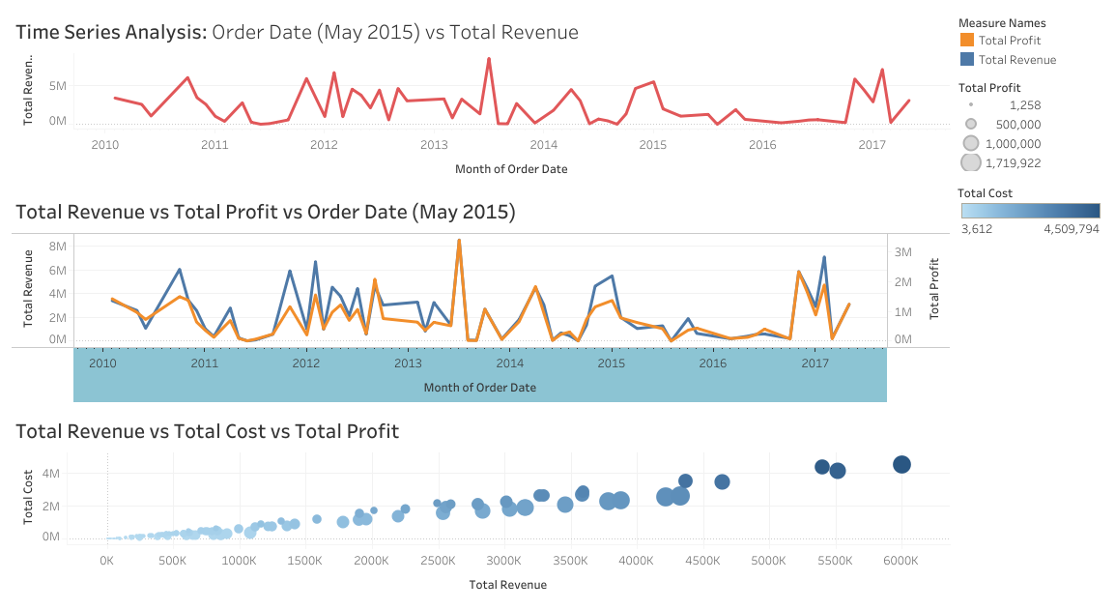

Slide 8
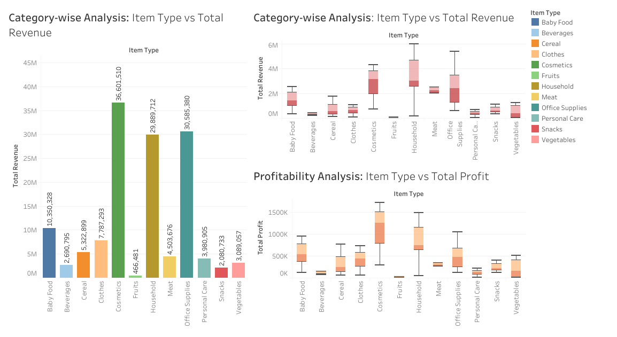

Slide 9
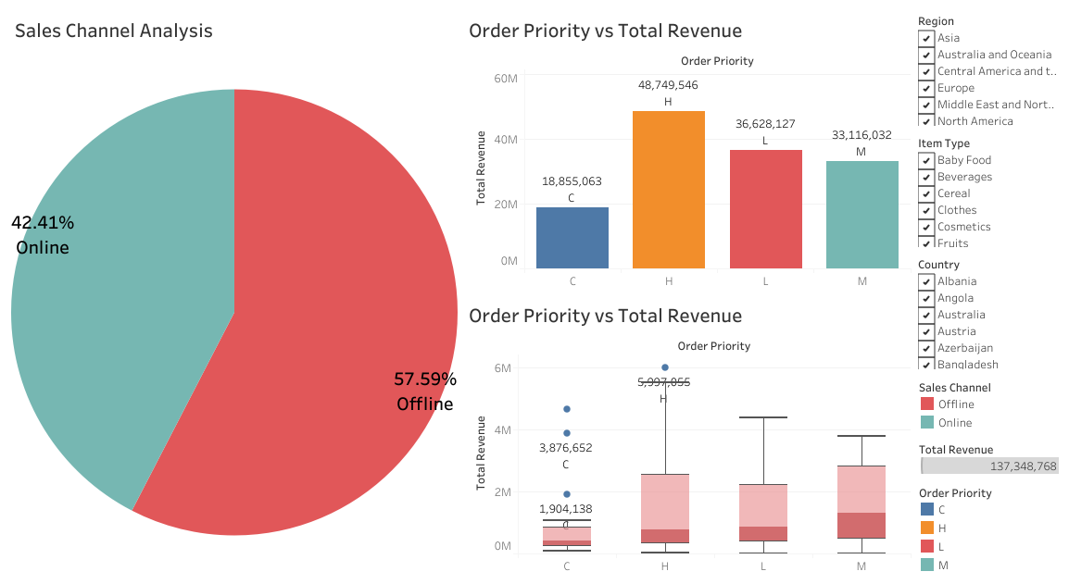

Slide 10


